Slide 1
Half scale blade test concept
9/12/16

Slide 2
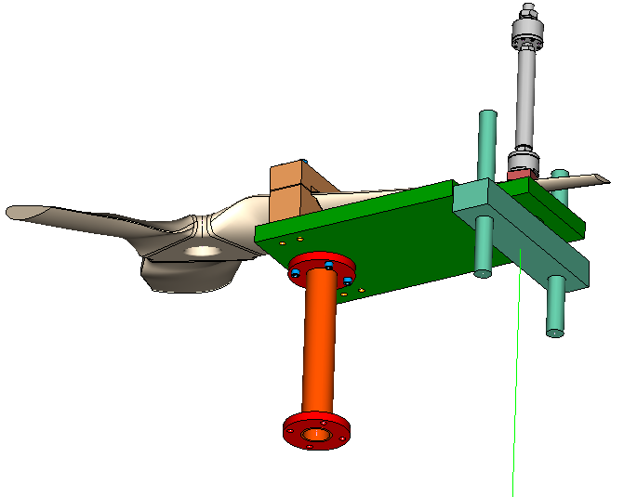
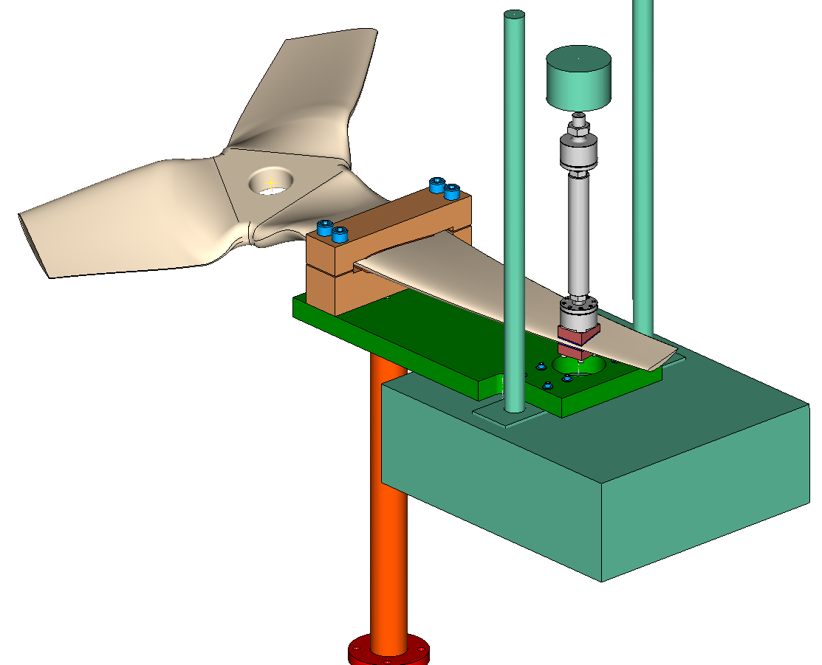
Half scale blade testing
Steel blocks
Aluminum plate, 2 inches thick

Slide 3
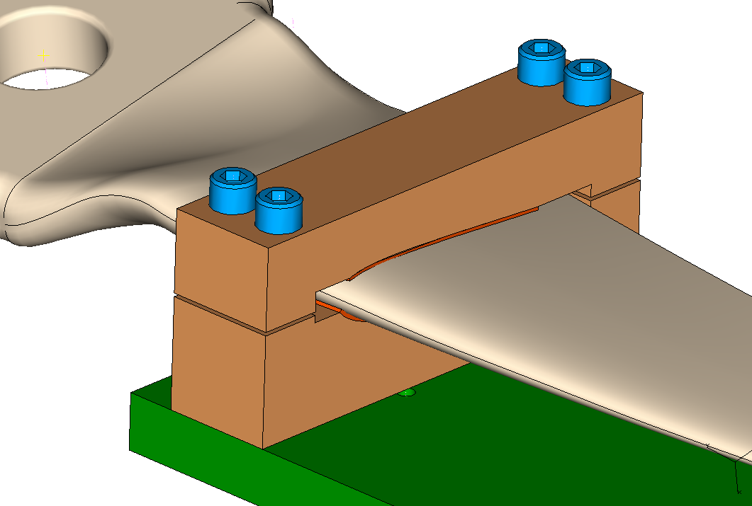
Blade clamping
1 inch socket head screws
Install shims after determining suitable preload
1/8 inch thick rubber sheet

Slide 4
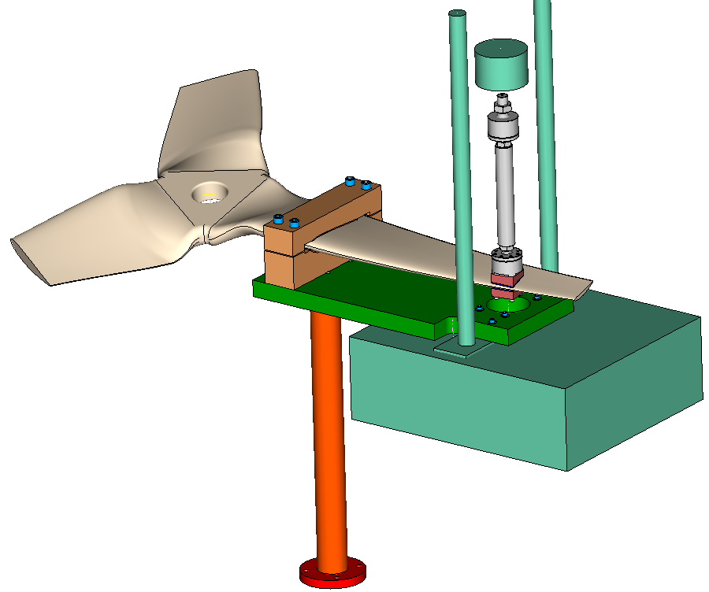
Vertical distances from table surface
Bottom surface of load cell positioned at 29 inches above table surface
29
Gap between top of adapter and bottom of load cell indicates that the spacing is sufficient
Bottom surface of adapter is 6 inches above table surface
6.0
0
36

Slide 5
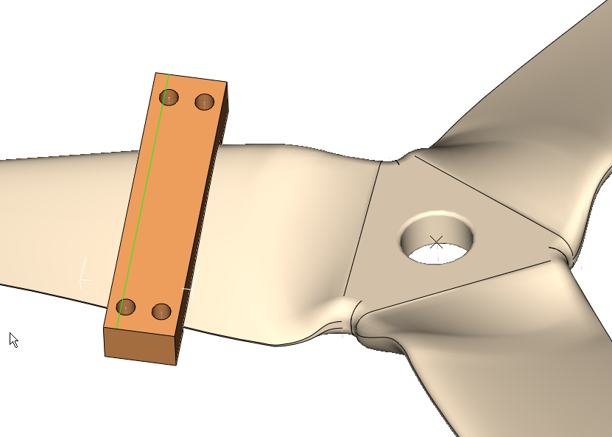
From this plane to this edge
11.04

Slide 6
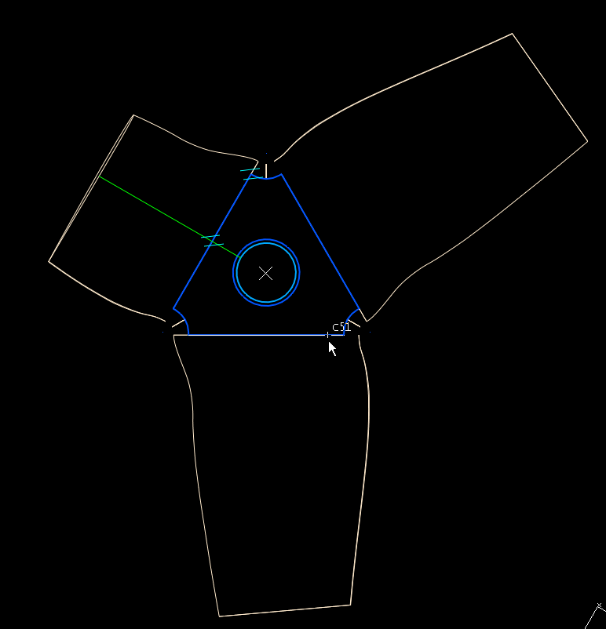
11.04

Slide 7
Test machine displacement/force
With clamp located as shown in previous figures,
displacement at load patch location for TDC point loading: 0.862 inch
displacement at load patch location for BDC point loading: 0.558 inch
Test displacement: 0.71 ± 0.152 inch
With load applied at load location shown in previous figures,
Load for TDC: 689 lbs.
Load for BDC: 445 lbs.
Test load: 567 ± 122 lbs.

Slide 8
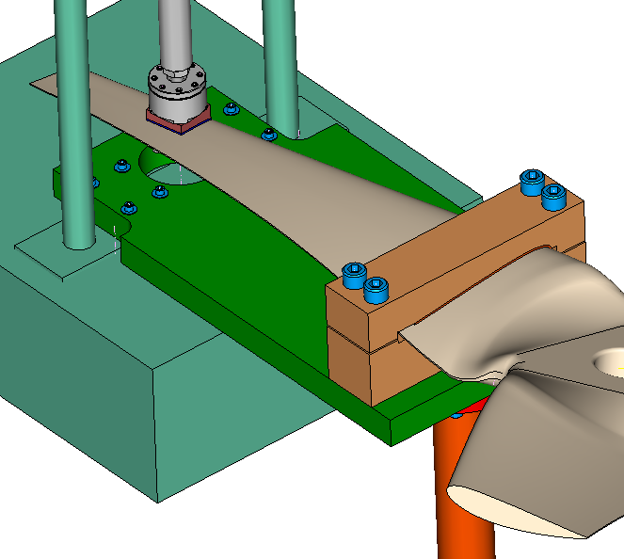
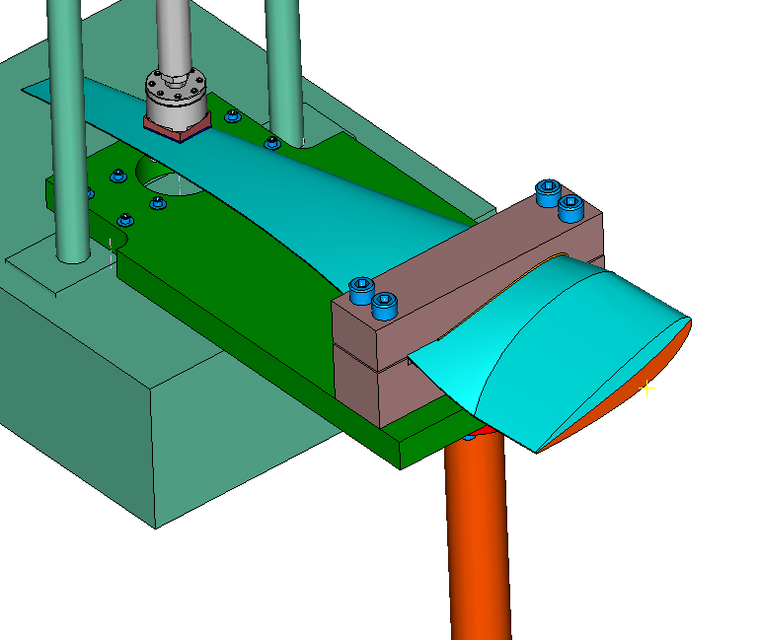
Alternate clamps required for Gen5d blade versus untwisted blade
Untwisted blade setup
Nominal blade setup
Make 2 sets of blocks for testing either…

Slide 9
Drawings required:
Half-scale rotor (existing)
(4) Machined steel blocks
Actuator assembly (existing)
(2) Machined steel blocks
(1) Machined part, Aluminum plate, 2 inches thick
Drawings:
7 Machined parts
1 Assembly
Pipe and pipe flanges (purchased)
Test machine (existing)

Slide 10
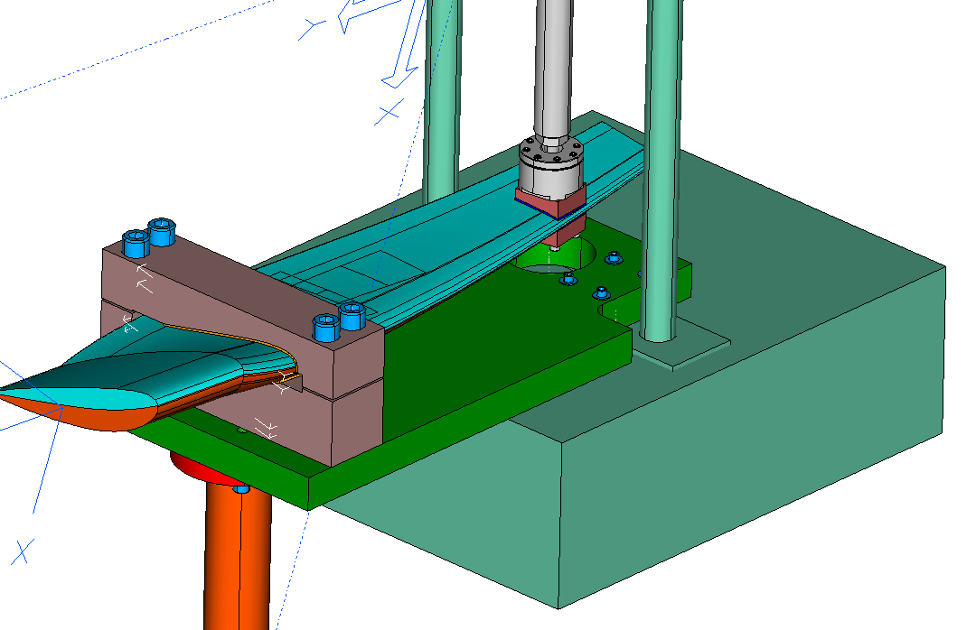
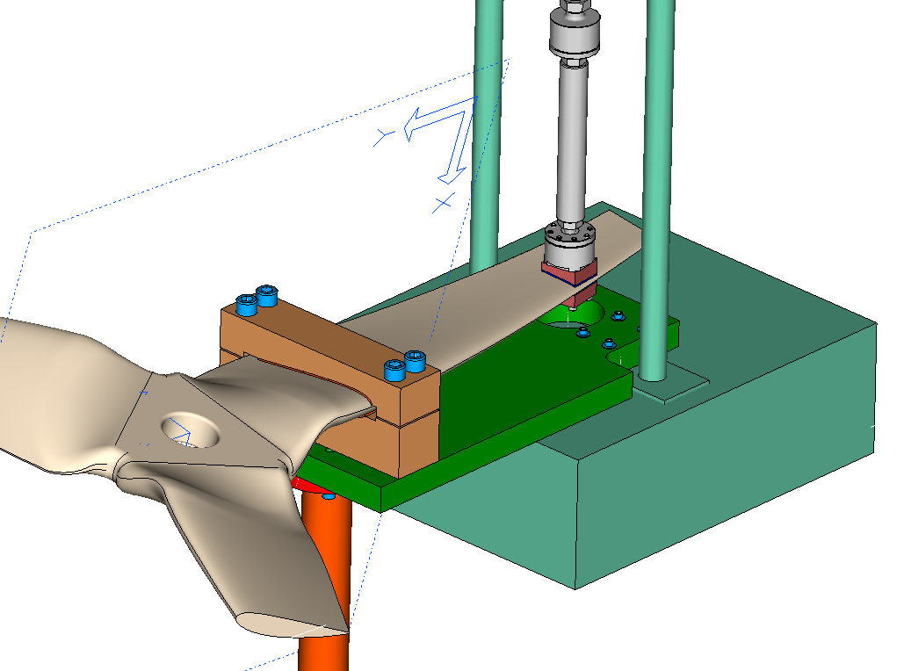
Assembly
Show 2 test setups
Single blade and its steel blocks and rubber sheets
3-blade rotor and its blocks and rubber sheets
(note, smaller blocks at loading location do not change)
Single blade test setup
3blade rotor test setup

Slide 11
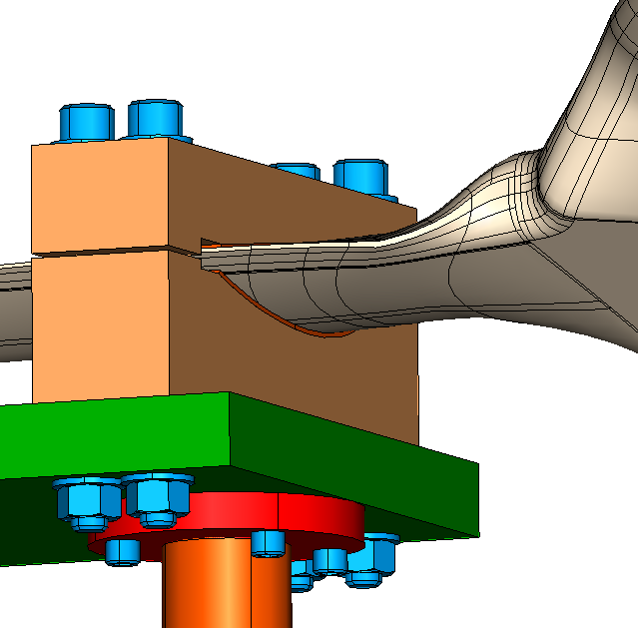
Changed to using nuts on 1 inch screws

Slide 12
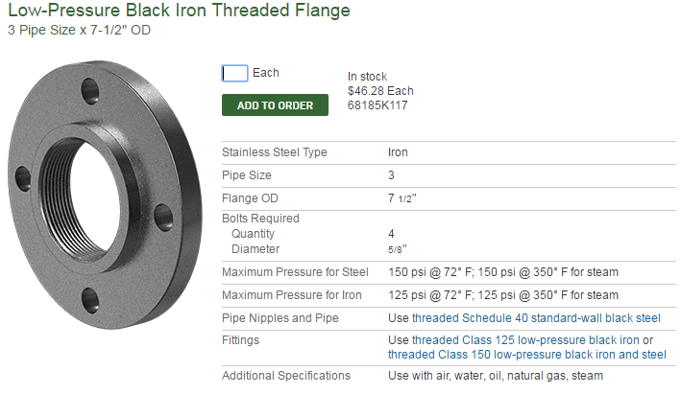
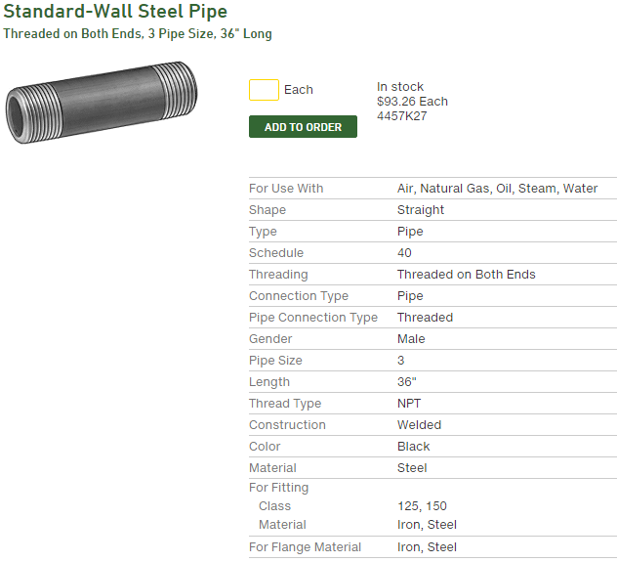
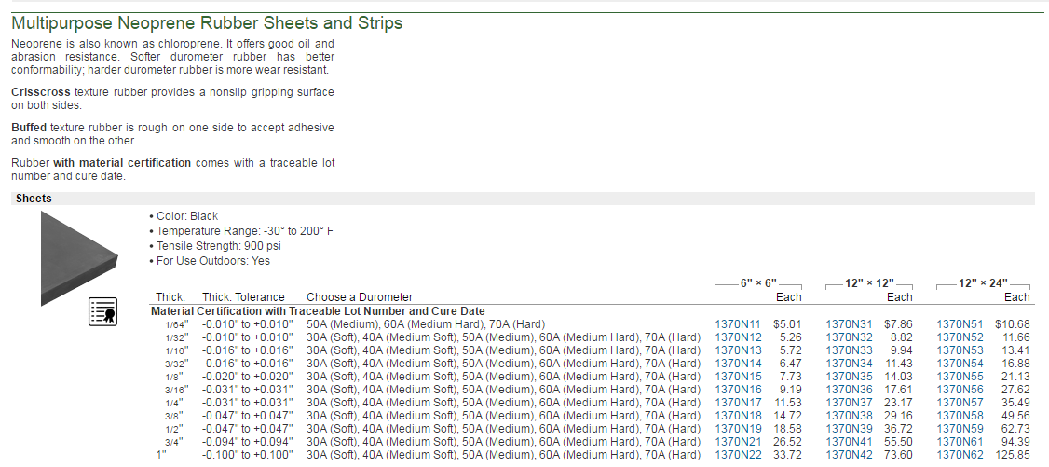
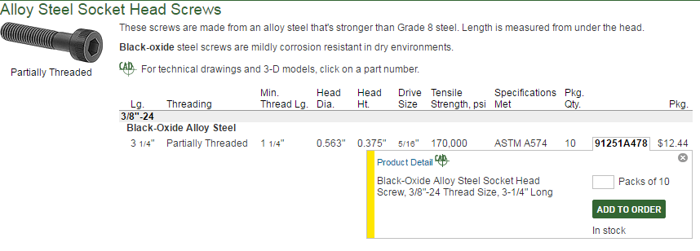
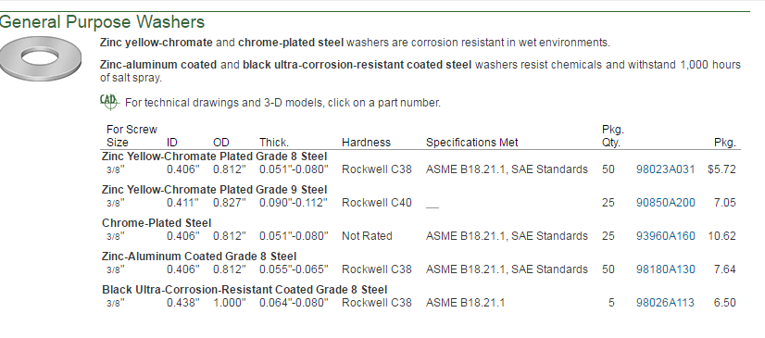
Purchased parts
Qty: 2
Qty: 1

Slide 13
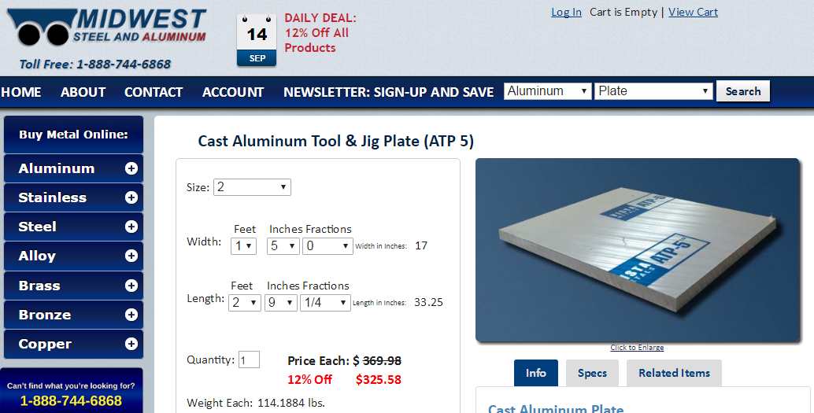
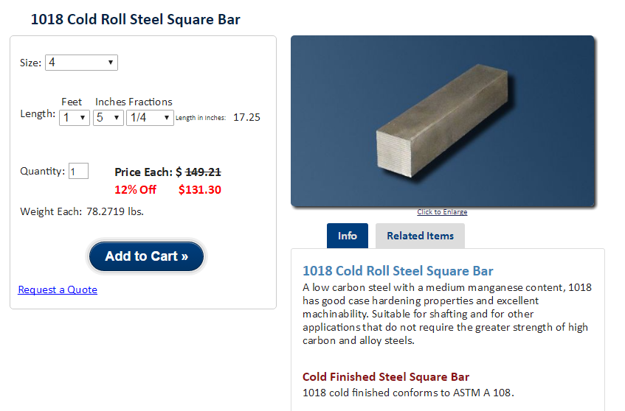
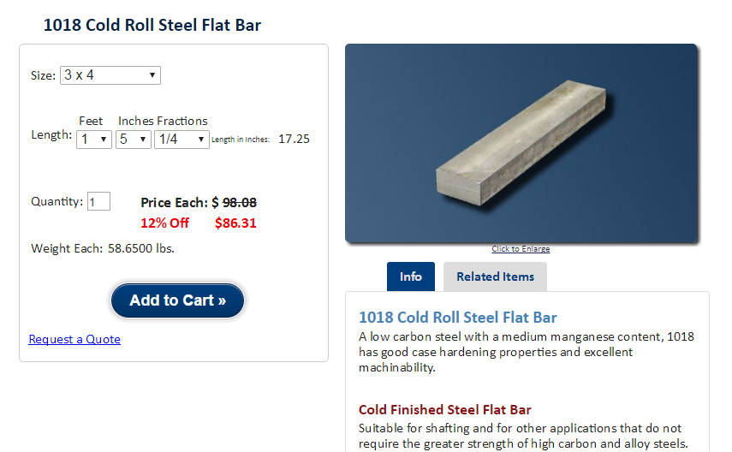
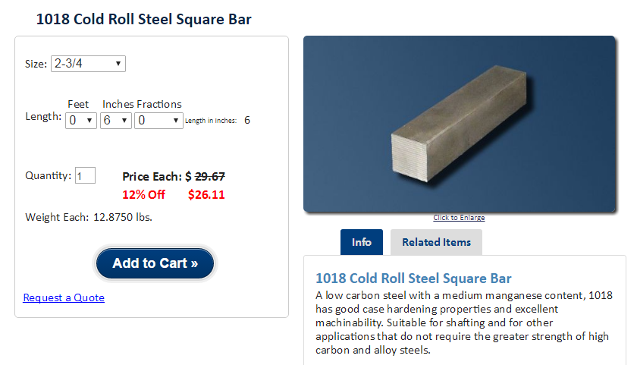
Alum plate: 33.25 x 17 x 2
Steel blocks: 2: 4 x 3 x 17, 2: 4 x 4 x 17
Steel blocks: 2: 2.75 x 2.75 x 1.375
Rubber sheet: .125 thick

